Slide 1

Temporal & Spatial changes of unemployment rate in contiguous usa
By Salsabil Chowdhury Tory
Ball State University
Fall 2023

Slide 2
Analyze the trends and cycles of unemployment rate at the national, state, and county levels over time in the US
Identify the states and regions with the highest and lowest unemployment rates. The spatial representation of the unemployment and crime rate changes over time.
Investigate the correlation between the unemployment rate and crime rate and how they vary across different states and regions
Goals

Slide 3
Data Cleaning and Processing
Data cleaning done in Rstudio using the dplyr library.
Data Wrangling, Filtering, Aggregating
Filter the year from 2007 to 2014.
Create a new table consisting of unemployrate and crimerate for year 2014
Importance of preparing clean data for analysis and visualization.
Notes:
.

Slide 4
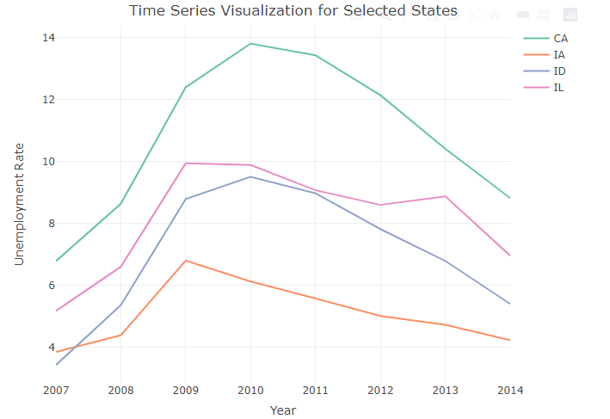
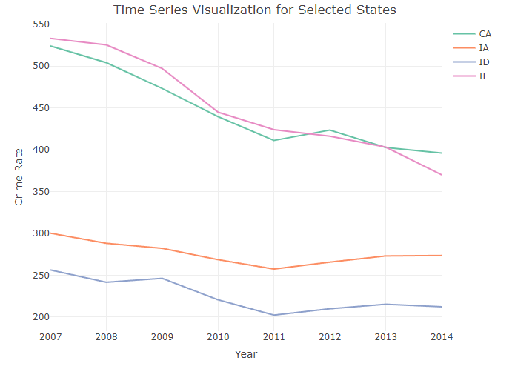
VVisualization
Overview of the plotting methods used (ggplot2, plotly).
Two time series line plots for unemployment and crime rates.

Slide 5
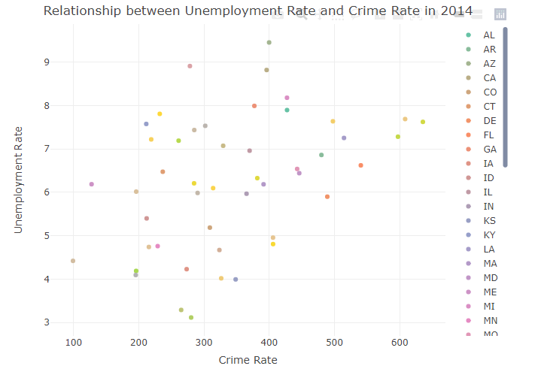
Visualization
Scatter plot illustrating the relationship between unemployment and crime rates in 2014

Slide 6
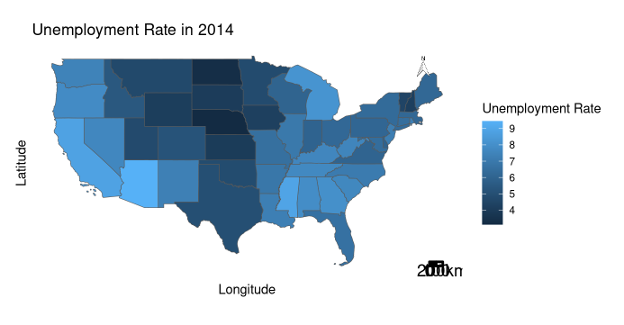
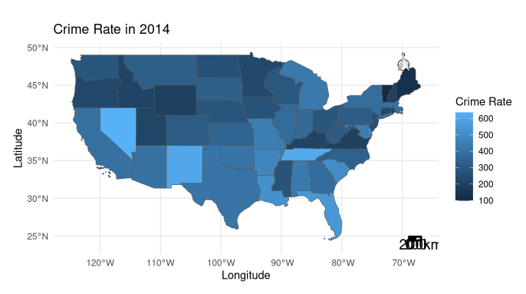
Visualization
Spatial maps for unemployment and crime rates in 2014.

Slide 7
Findings and Discussion
Summary of key findings:
Complex relationship between unemployment and crime rates.
Significant differences among states and regions.
Temporal and spatial changes in variables.
Discuss implications and correlation between unemployment and crime rates.
Pros and cons of the approach used in the project

Slide 8
Thank You

